Slide 1
Statistics by Position in the NBA V2
By Sam Kaseff and Sean Patrick King

Slide 2
Introduction
In our last presentation we concluded that centers are generally better at shooting field goals, worse at shooting 3 pointers, and worse at shooting free throws. Our hypothesis this time around is that the graphs should not change much year by year, and postseason games will have more variance in their stats. We will do this by:
Looking back at historical NBA data from the past five years to determine if the stats have changed at all.
Also looking at defensive stats such as blocks per game and steals per game.

Slide 3
Method
01
02
03
04
AWS Glue
Created a Jupyter notebook within glue to web scrape NBA data from ESPN’s internal API and from the years 2019 to 2024 and transformed into a dataframe.
AWS Glue
Created visualizations using the scraped data from all of the years. Each visualization shows how the percentages change over the years.
AWS Glue
Have the program run every day and update the visualizations.
Output
Automatically save the daily dataframe and the visualizations into an S3 bucket in a folder corresponding to the date. This allows us to look back at the years and compare the current NBA season to past seasons.

Slide 4
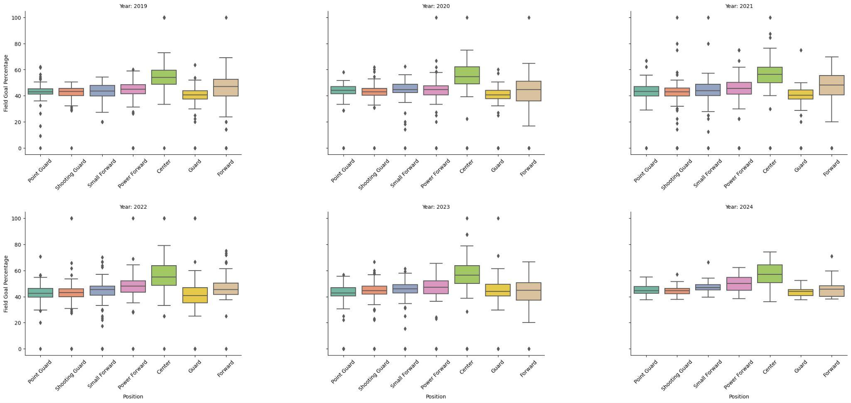
Field Goal Percentages by Year
-Centers made the highest amount of field goals throughout each year of the data.
- This shows that centers being better at field goals than the average player is not a trend that started this season and has been true historically.

Slide 5
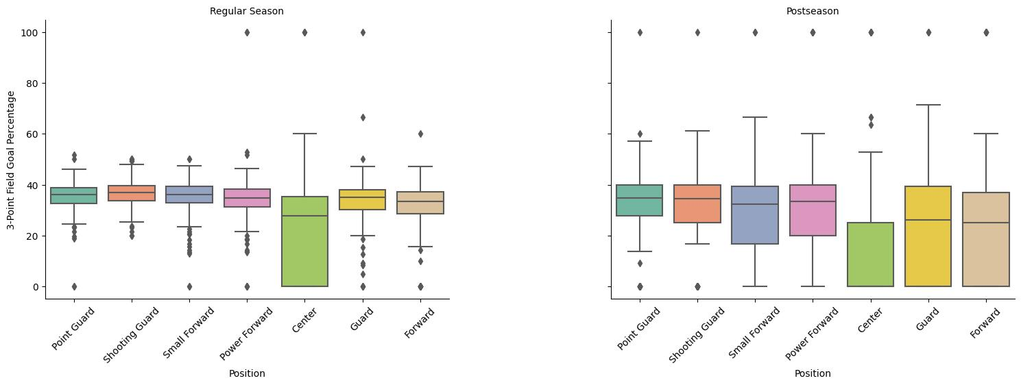
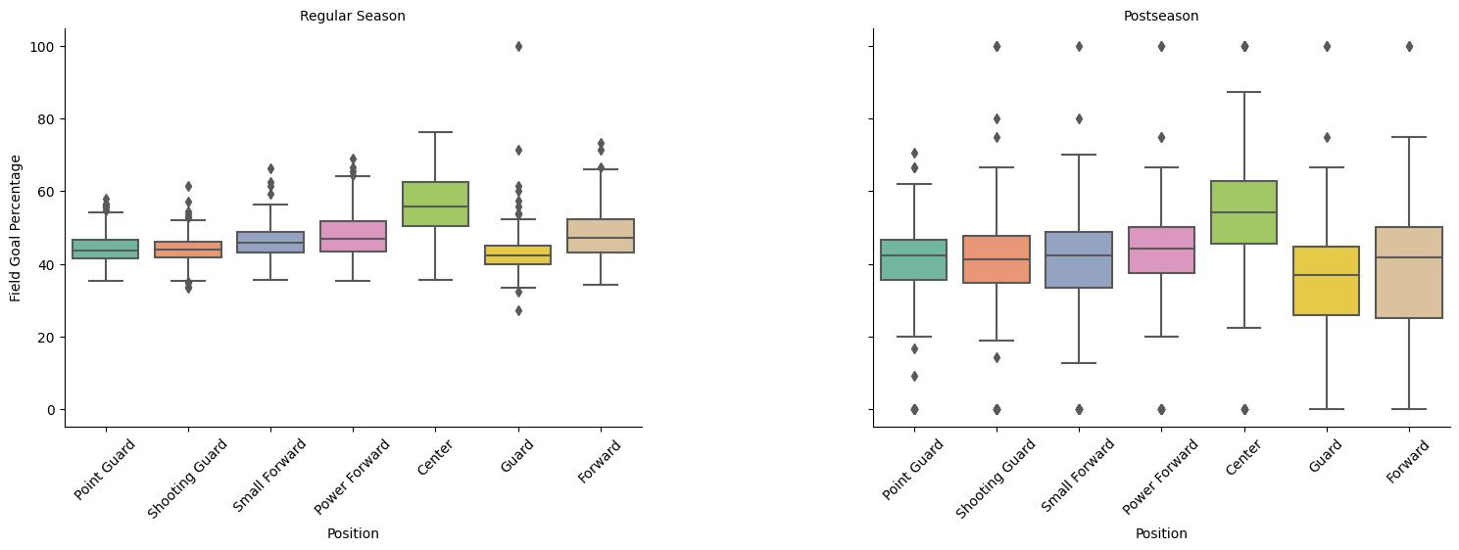
Regular Vs. Post season
-Post season, centers performed about the same, and all positions had greater variance in this statistic.

Slide 6
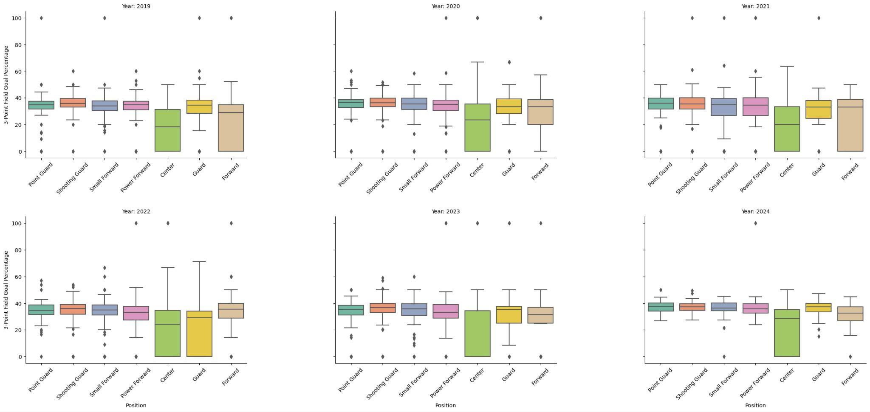
3 Pointer Percentages by Year
-Centers were also consistently the worst 3-Point shooters
-Some positions have performed just as badly as centers in this category, such as forwards in 2019 and 2021 and guards in 2022.

Slide 7
Regular Vs. Post season
-Post season, centers performed slightly worse than they did in the regular season in 3 pointers.

Slide 8
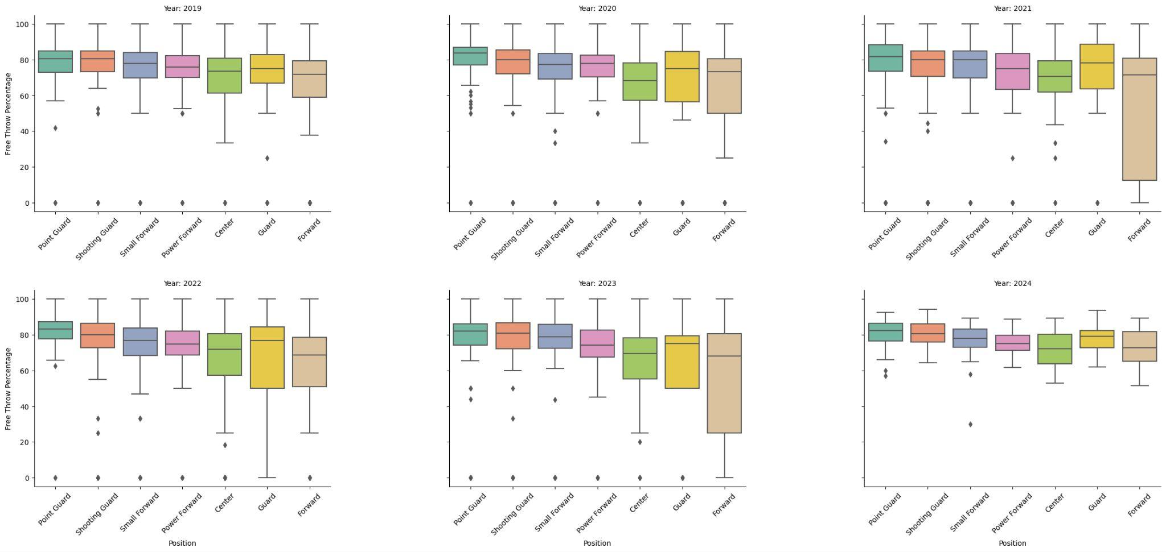
Free Throw Percentages by Year
-Centers historically performed about average among the positions in free throws throughout the last 5 years.
- By looking at the historical data we can see that there are some years where forwards performed far worse than other years in free throws.

Slide 9
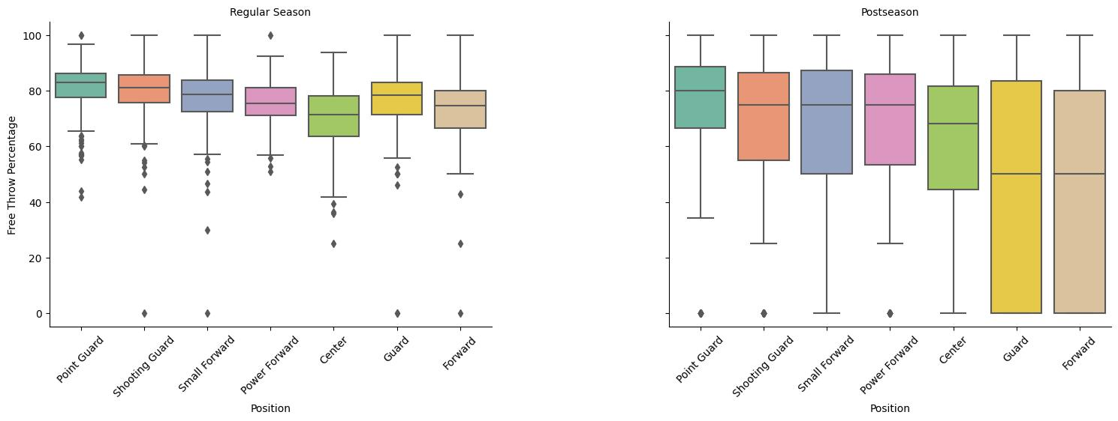
Regular Vs. Post season
-Post season, centers performed about the same that they did in the regular season in free throws.

Slide 10
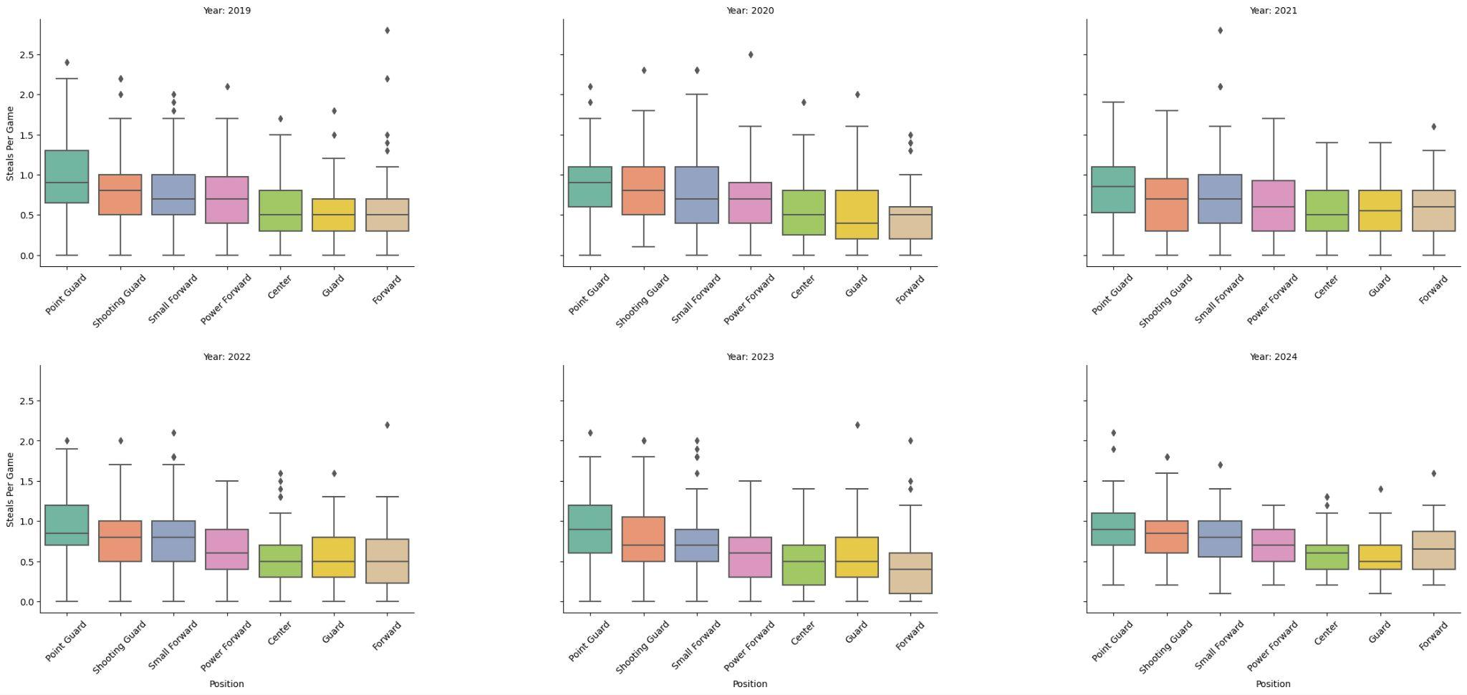
Steal Percentages by Year
-Centers have performed consistently slightly below the average of all other positions when it comes to steals.

Slide 11
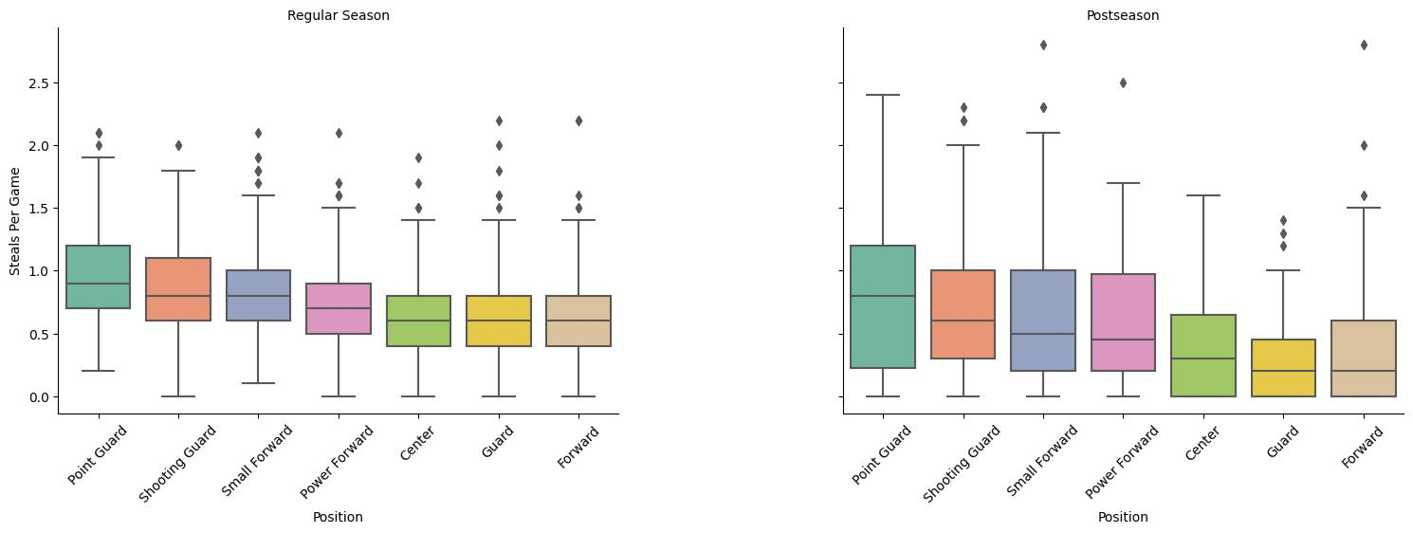
Regular Vs. Post season
-Post season, centers performed worse than they did in the regular season in steals.

Slide 12
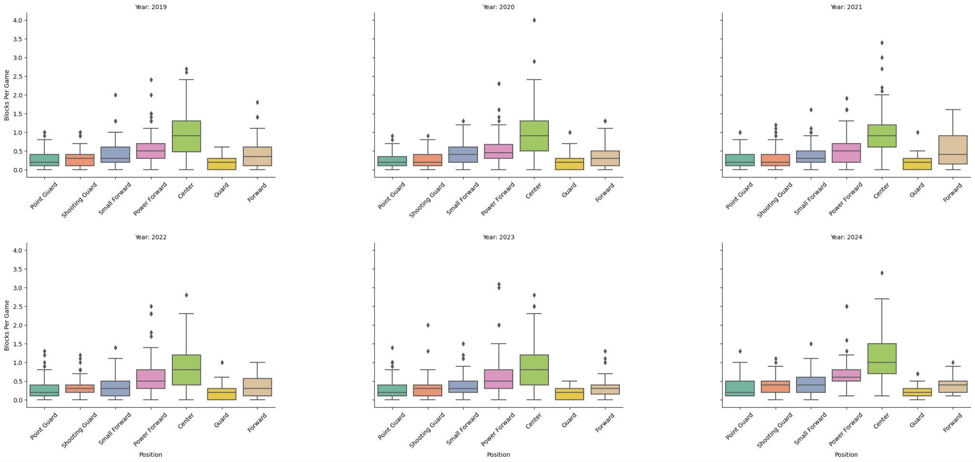
Block Percentages by Year
-Centers made the highest amount of blocks throughout each year of the data.
- This shows that centers are better than the average player at blocks. This has been true historically but there is some variance year by year.

Slide 13
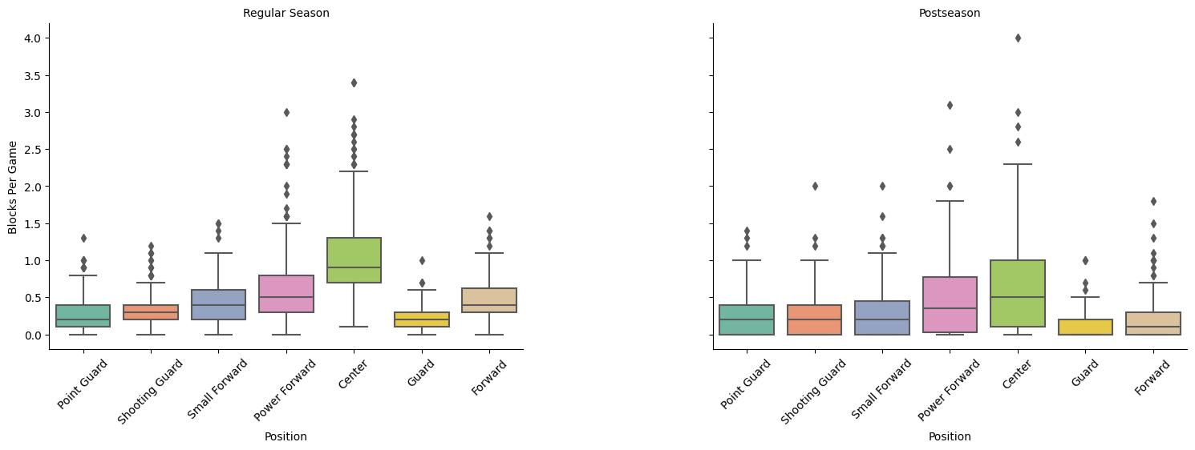
Regular Vs. Post season
-Post season, centers performed worse than they did in the regular season in blocks.

Slide 14
Conclusion
Historical NBA data from the past five years confirms that centers consistently show higher field goal percentages and lower three-point and free throw percentages, indicating stable offensive roles.
Year-by-year variance was observed in defensive stats like blocks and steals per game, this suggests fluctuations in centers' defensive impact due to strategies and individual player skills.
The regular season vs. postseason comparison revealed consistency in how the positions compared to each other, with an increase in variance, due to the sink-or-swim nature of the playoffs.

Slide 15
Thanks!
Questions?

